Slide 1
Lunar Phase Influence On Crime in Austin Texas
Rice-hou-data-pt-01-2021
Team: Jon Argoitia, Erin O'Brien, Gregory Talbott & Fatima Shami

Slide 2
8-Phases of the lunar cycle
When sunlight reflects off the near side, we call it a full Moon. The rest of the month we see parts of the daytime side of the Moon, or phases. These eight phases are, in order, new Moon, waxing crescent, first quarter, waxing gibbous, full Moon, waning gibbous, third quarter and waning crescent. The cycle repeats once a month (every 29.5 days).
Retrieved from https://solarsystem.nasa.gov/moons/earths-moon/lunar-phases-and-eclipses/ on March 11, 2021

Slide 3
Problem statement
Our project is to uncover patterns in criminal activity in Austin influenced by four of the eight lunar phases. Covering data between 2014 to 2021. We'll examine relationships between types of crime and moon phase; crime rates and moon phase; and related questions, as the data admits.

Slide 4
Hypothesis and question(s)
H1: Incidents of crime in Austin, Tx increase as the lunar cycle approaches the full moon phase
H0 : Incidents of crime in Austin, Tx do not increase as the lunar cycle approaches the full moon phase
Q1. Is there a positive relationship between major crimes and reported incidents over time (per day) ?
Q2. Is there a positive relationship between major crimes reported and nonviolent crimes reported by moon phase?
Q3. Is there a correlation between moon phase and assault, intoxication, and theft crimes?
Q4. Is there an increase in minor (stupid) crimes as the lunar phase approaches the full moon phase?

Slide 5
DATA Analysis
The crime data API was collected from https://data.austintexas.gov/Public-Safety/Crime-Reports/ for years 2014 to 2021
A .csv file was created for the moon phase data by putting the data collected for moon phase and time in excel and save from link https://www.calendar-12.com/moon_phases/

Slide 6
summary statistics
Criminal Activity Reports and Lunar Phases were object type data and summary information is relegated to counts
There were a total of 23,222 Lunar Phases reported across the cleaned/combined dataset focusing on Theft; Disturbance; Burglary; Assault; Intoxication Crime; Criminal Mischief; Drug Related; Fraud; Harassment; and Runaway Child

Slide 7
major crimes vs total number of reports for a day
Lunar Phases
First Quarter 19,272
Last Quarter 19,213
New Moon 19,141
Full Moon 18,776
Major Crimes and Number of Reports
THEFT 124,599
DISTURBANCE 101,170
BURGLARY 93,318
ASSAULT 76,263
INTOXICATION CRIME 39,901
CRIMINAL MISCHIEF 35,115
DRUG RELATED 31,911
FRAUD 31,587
HARASSMENT 17,185
RUNAWAY CHILD 12,995
* The number of Lunar phases is far less than the number of major crimes reported

Slide 8
moon phase cycle and intoxication crimes reports by day
INTOXICATION CRIME
39,901
Lunar Phases
Full Moon 1,395
Last Quarter 1,392
New Moon 1,381
First Quarter 1,372
* The number of Lunar phases is far less than the number of intoxication crimes

Slide 9
moon phase and assault crimes
ASSAULT 76,263
Lunar Phases
First Quarter 2,623
New Moon 2,600
Last Quarter 2,596
Full Moon 2,546
* The number of Lunar phases is far less than the number of assault crimes

Slide 10
compare violent crime and nonviolent crime trends to see if one or the other changes with moon phase
Theft Crimes
THEFT 124,599
BURGLARY 93,318
Moon Phases
First Quarter 7,453
New Moon 7,412
Last Quarter 7,257
Full Moon 7,245
* The number of Lunar phases is far less than the number of theft crimes

Slide 11
Drug crimes
Lunar Phases
First Quarter 1,126
Last Quarter 1,124
Full Moon 1,033
New Moon 1,025
DRUG RELATED
31,911
* The number of Lunar phases is far less than the number of drug related crimes

Slide 12
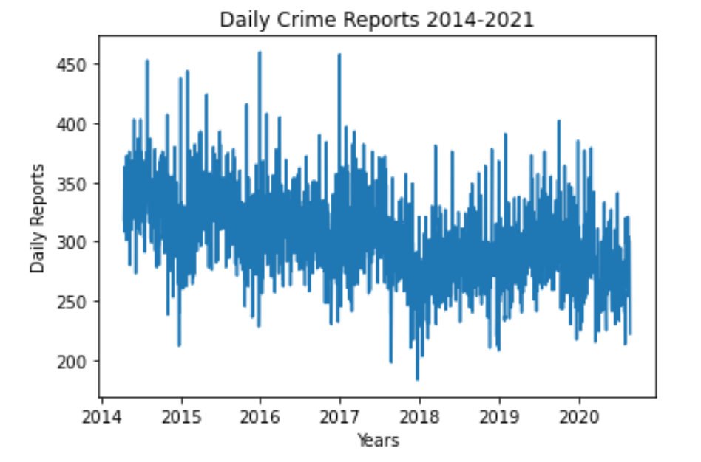
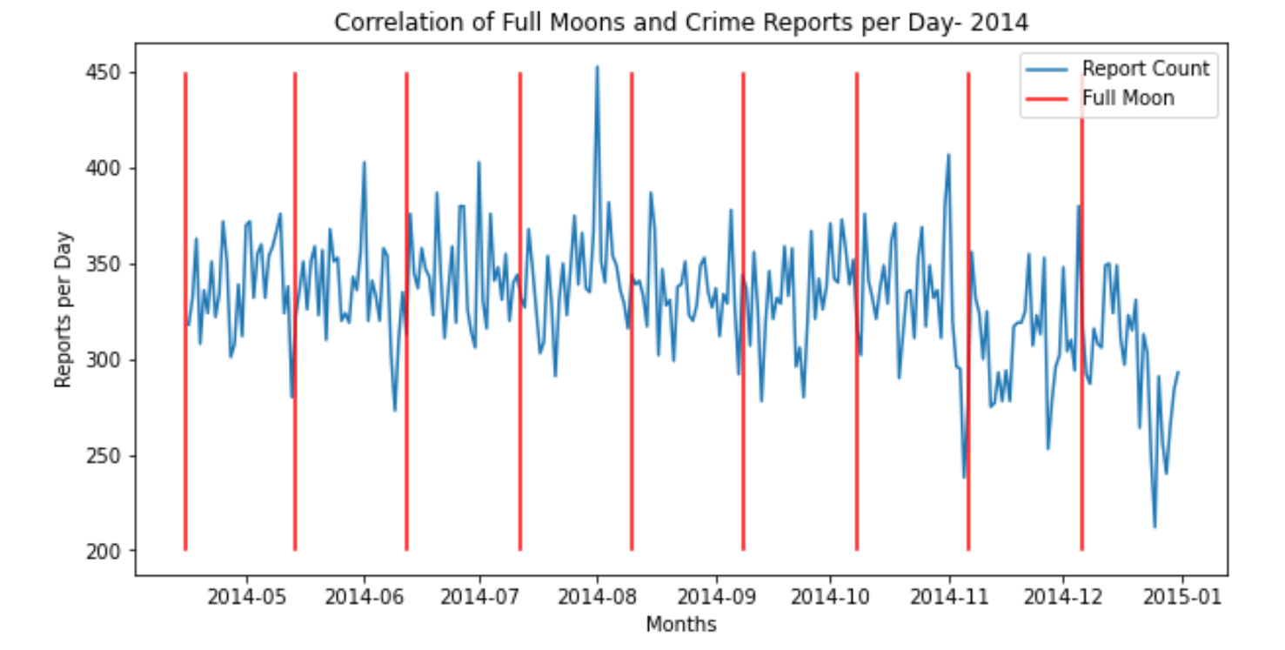
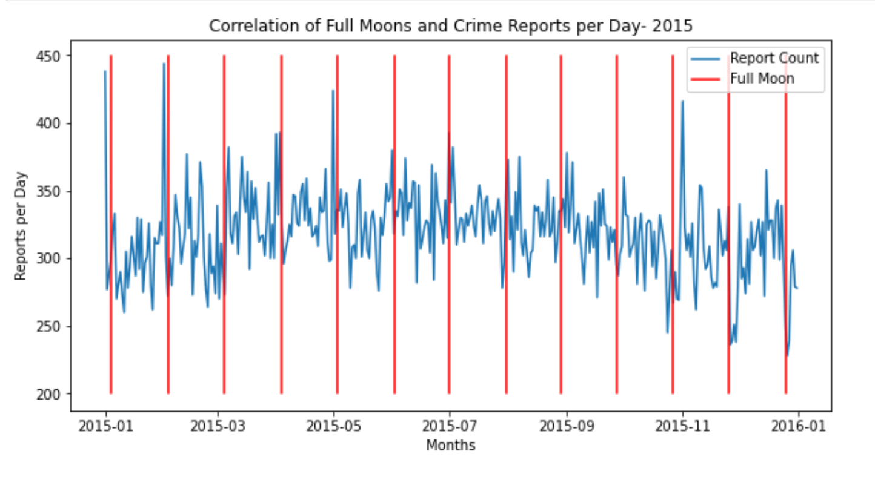
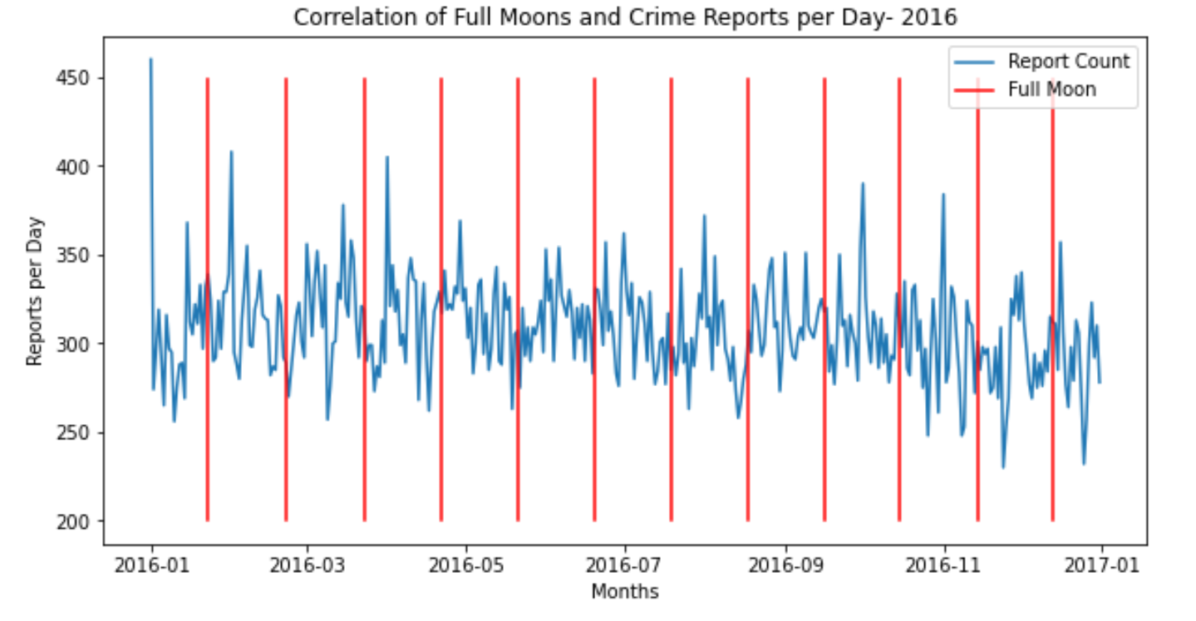
Crime reports over the years
Plotted daily crime rates over time by the entire study years as well as by single year
The data is very noisy and difficult to interpret on a line graph
Determined more robust summary statistics were necessary to interpret the data

Slide 13
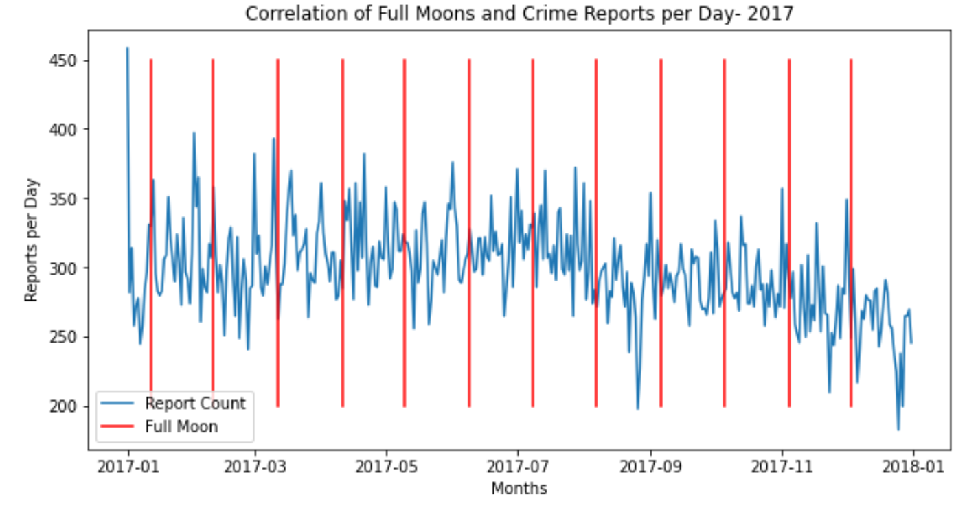
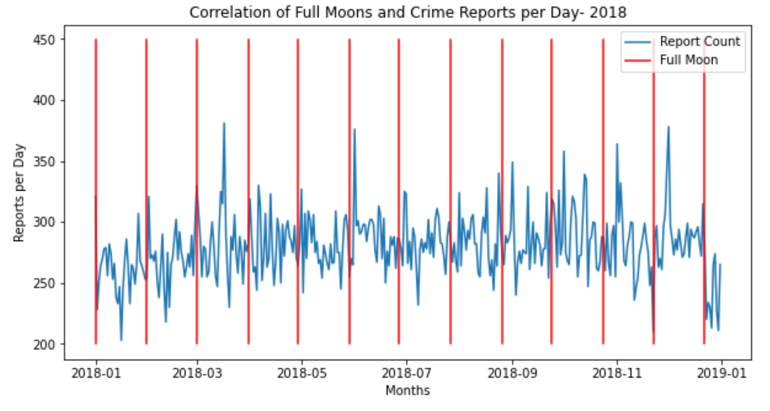
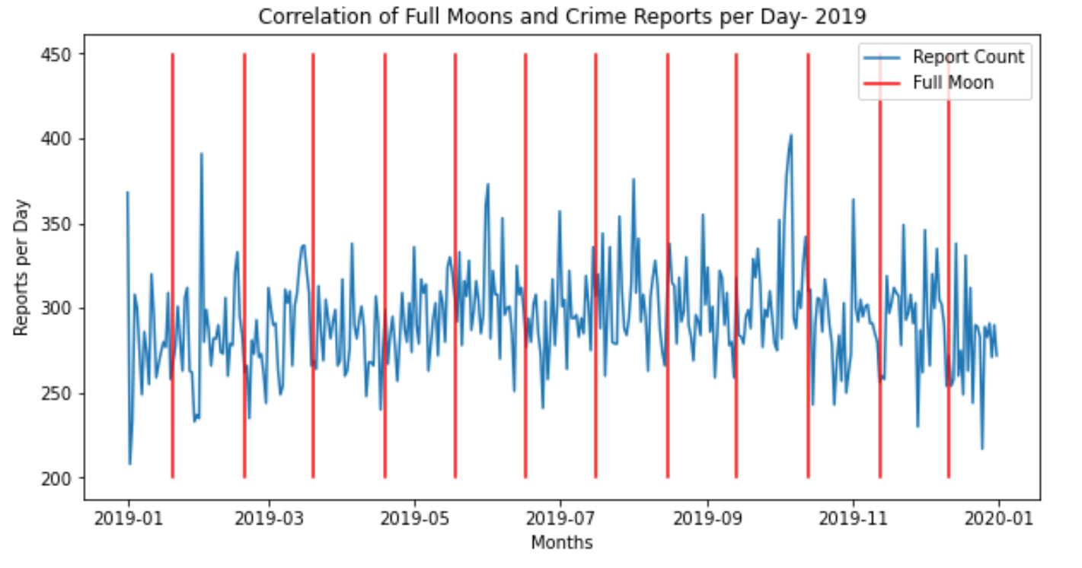
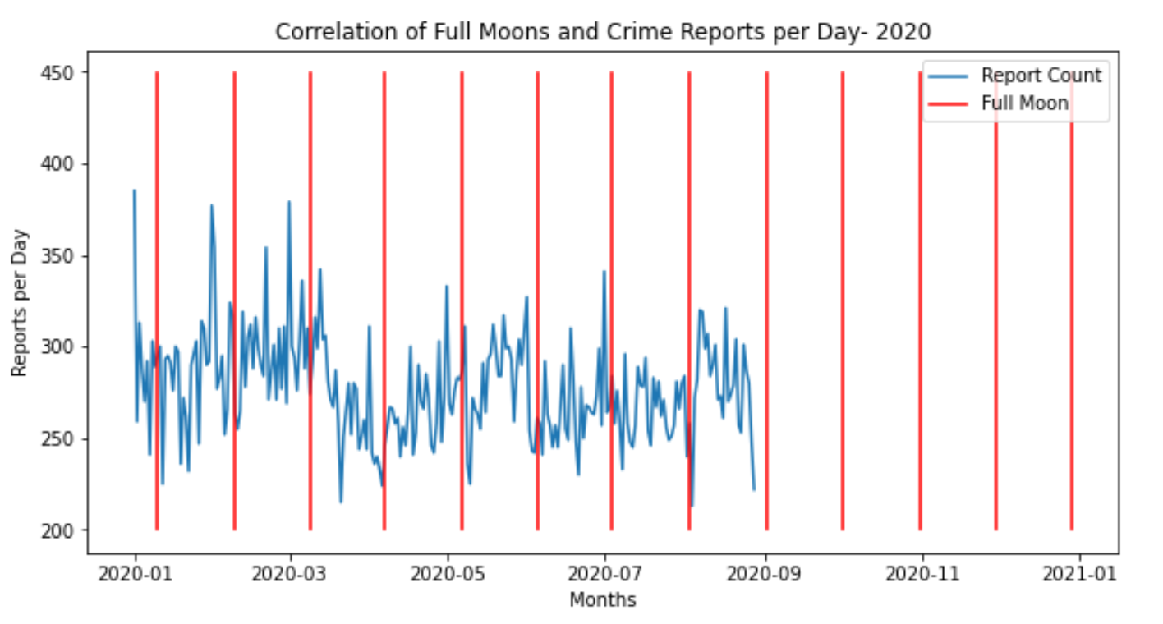
Crime Reports Over the Year Cont.

Slide 14
Comparing high crime holidays and full moon
Data was selected over 3 years (2015-2017) for four months with important holidays:
January –New Years
July – 4th of July
October - Halloween
December - Christmas
Data was analyzed to see if there was a correlation between the holidays, the full moon and crime reports

Slide 15
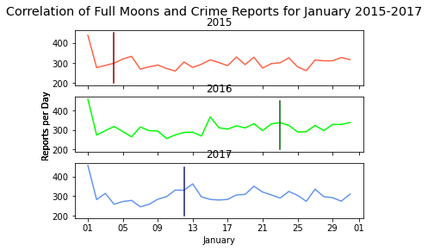
Comparing high crime holidays and Full moon
When comparting New Years (1st of January) the crimes reported were above 400
The days the full moon was out the crime rate reports varied randomly

Slide 16
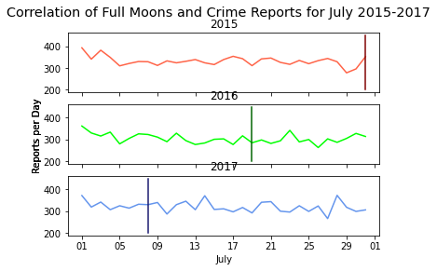
Comparing high crime holidays and full moon
There was no crime correlation for 4th of July (American independence day)
Crime reports were higher on the 1st of the month
The reported crimes varied on the days of full moon

Slide 17
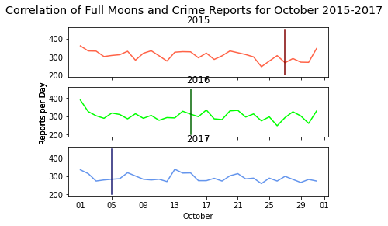
Comparing high crime holidays and full moon
When compared to Halloween (October 31st) there was a high crime trend for the years 2015 and 2016 but not 2017
Crimes reported were high on the first of the month
The days the full moon showed no trend

Slide 18
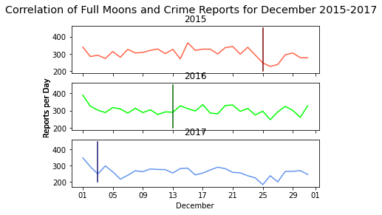
Comparing high crime holidays and full moon
Crime reports decreased around Christmas (25th December)
Crime reporting rates were higher on the 1st of the month
There was no relation between the full moon and crimes reported

Slide 19
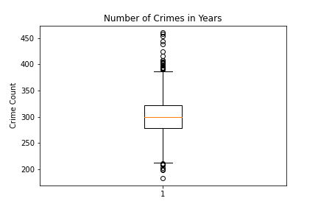
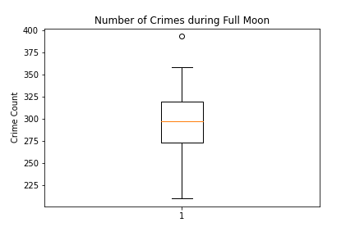
Comparing Overall Crime with Crime during full moon
When one compares the overall data for crime reports with just the crime reports for the full moon, we can see a clear see a similar mean in both crime reports
There is also more variance in the Number of Crimes in Years than the Number of Crimes during Full Moon, but that is more than likely due to the higher number of data for Crimes during Years

Slide 20
Conclusions
There was no correlation between the full moon and crime reported
The number of crime incidents far outnumber the lunar phases
Crimes reported were highest for 1st of January for all years chosen
There was an overall increase in the crime reports on the 1st of the months chosen
Crime reports decreased during Christmas time

